Slide 1
CAN PROTOCOL
(Controller area network)

Slide 2
INTRODUCTION
CAN bus is a vehicle bus standard designed to allow microcontroller and devices to communicate with each other in vehicle.
It is a message based protocol.
It can send up to 8 bytes of data
It is present in both physical and data link layer of OSI layers.
It is a multi-master, multicast serial bus .
Standardized by ISO 11898-1, 11898-2
High Fault tolerance

Slide 3
HISTORY
To reduce communication complexity on automobiles BOSCH starts work on CAN protocol in 1983, and official CAN released in 1986.
Intel/ Philips are the fist manufacture of CAN based microcontroller in 1987.
In 1991 CAN based first luxury car released by Mercedes Benz

Slide 4
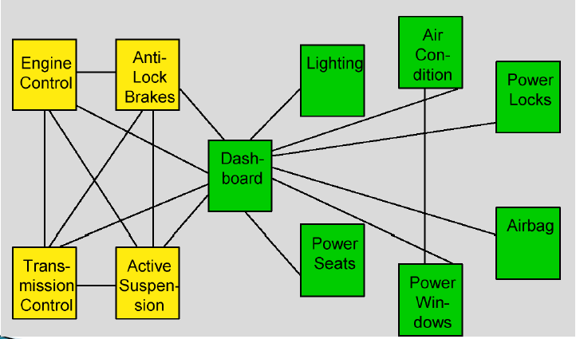
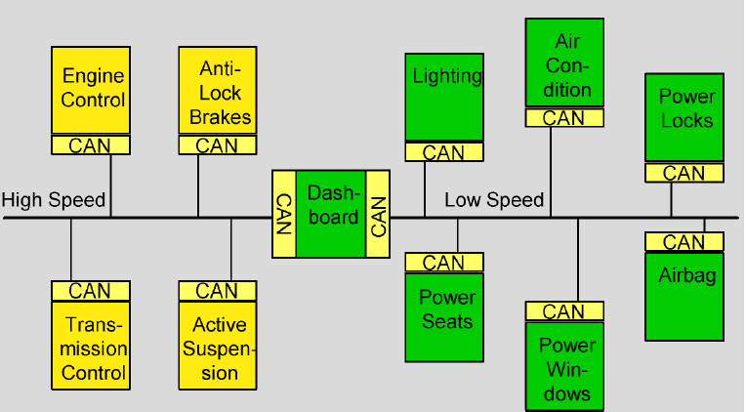
Before and After CAN

Slide 5
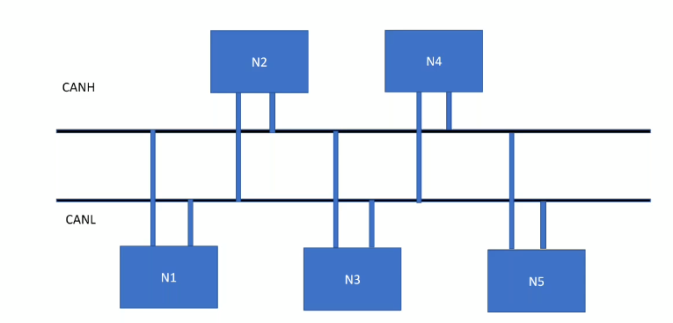
CAN STRUCTURE
Dominant - 0
Recessive - 1
Dominant voltage level - 1.5v to 2.5v
Recessive voltage level - Above 2.5v

Slide 6
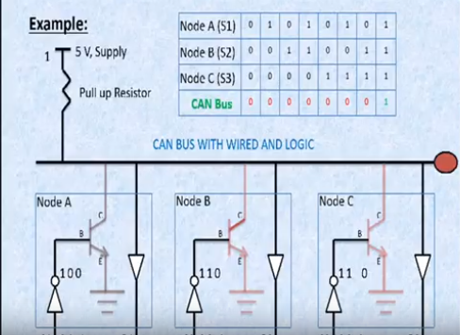
WIRED AND LOGIC

Slide 7
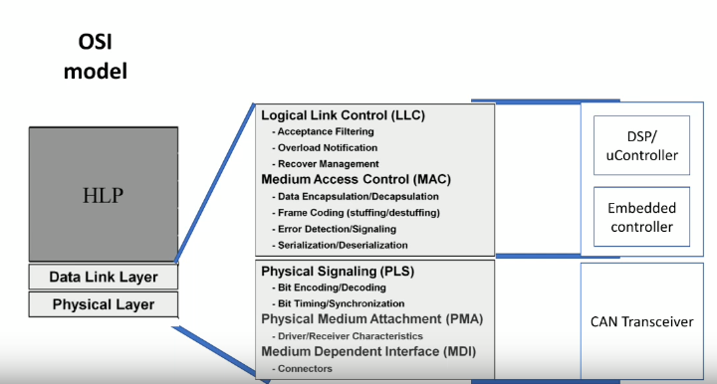
CAN with different layers in OSI model

Slide 8
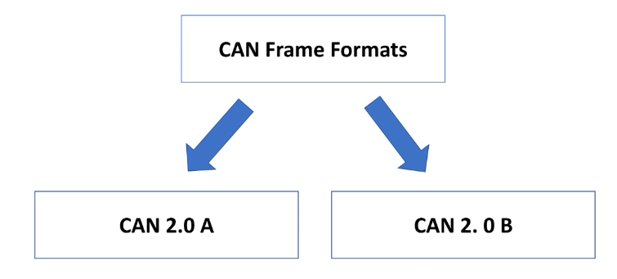
CAN FRAME FORMATS

Slide 9
TYPES OF FRAMES
Data frame
Error frame
Remote frame
Overload frame

Slide 10
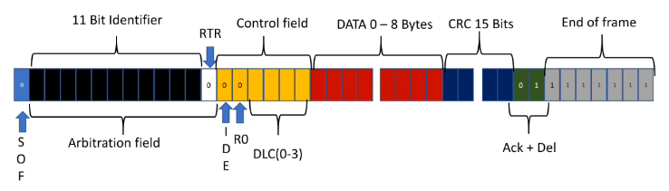
Data frame
RTR - Remote Transfer Request
IDE - Identifier Extension Bit
DLC - Data Length Code
CRC - Cyclic Redundancy Check
EOF - End Of Frame

Slide 11
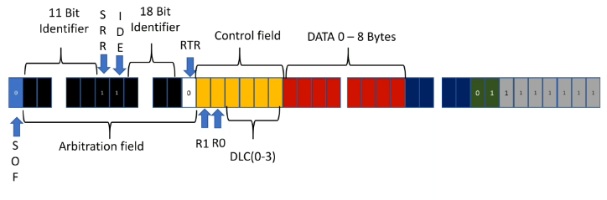
CAN 2.0 B EXTENTED FORMAT

Slide 12
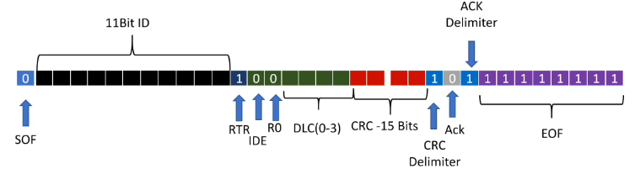
Remote frame 11bit identifier

Slide 13
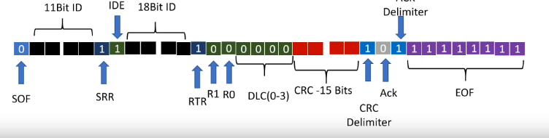
Remote frame 29bit identifier

Slide 14
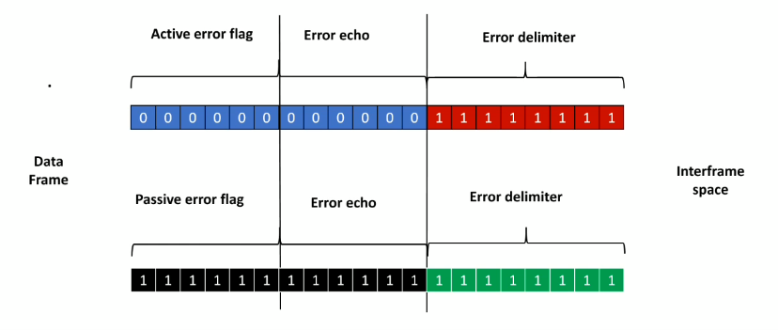
ERROR FRAME

Slide 15
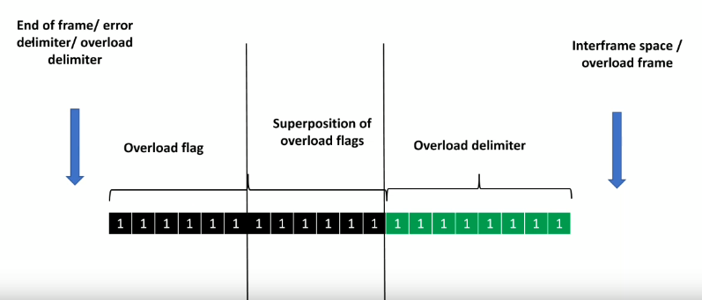
Overload frame

Slide 16
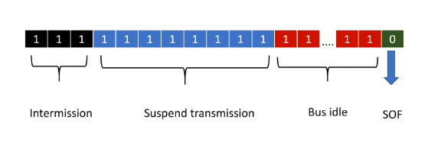
Interframe space

Slide 17
TYPES OF ERROR
CRC Error
ACK Error
Form Error
Stuff Error
Bit Error

Slide 18
CRC Error
NODE 2
CAN H
ACK 0
CRC error flag
CRC error flag
CAN L
CRC
ACK 0
1
0
NODE 1
NODE 3

Slide 19
Form Error:
Form Error occur when recessive bits are changed as a dominant bit
Eg: End of frame, ACK delimiter, CRC delimiter , interframe space
Stuff Error:
Stuffing is a concept in communication Network to avoid the excessive DC component
Complementary bit added after 5 successive same bit

Slide 20
Fault confinement
Active Error flag (continuous 8 dominant bits)
Passive Error flag
Bus off

Slide 21
11
10
8
REC
NODE 2
TEC
1+8=9
1
CAN H
000 000
Error echo
0
1 bit error
Rt
Rt
CAN L
000 000
REC
NODE 1
TEC
REC
NODE 3
TEC
20
12
16
21
19
If REC or TEC <=128
It becomes a passive error
20
If REC or TEC <=256
It goes to bus off state

Slide 22
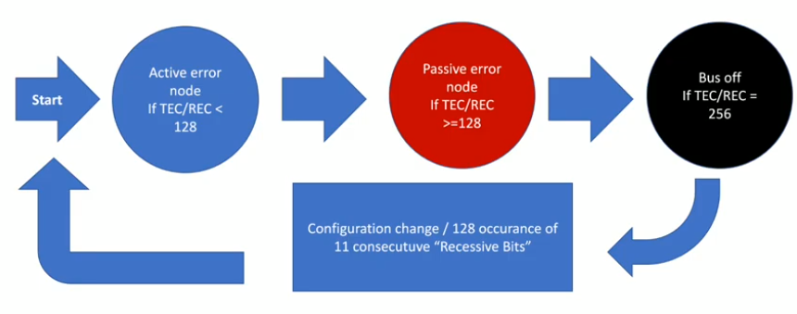

Slide 23
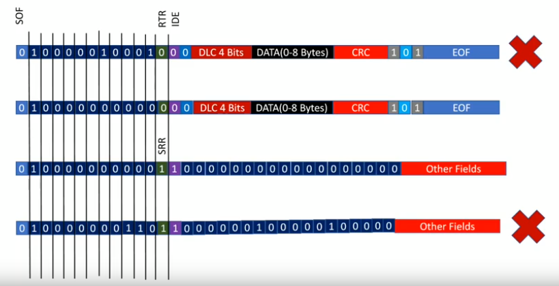
Multi master arbitration Data frame
NODE 1 (11bit)
NODE 2 (11bit)
NODE 3 (29 bit)
NODE 4 (29bit)

Slide 24
CAN ISOTP
A Classical CAN frame can carry maximum of 8 bytes of data
With ISO-TP:
The message is divided into multiple CAN frames and reconstructed by the receiver.
Types of ISO-TP Frames
Single Frame (SF)
First Frame (FF)
Flow Control (FC)
Consecutive Frame (CF)

Slide 25
CAN ISOTP - Single Frame (SF)
Used when the message size is 7 bytes or less.
CAN Frame Structure
PCI (protocol control information)
CAN ID
DLC
PCI
DATA (1 to 7 bytes)
0x7E0
8
07
01
02
03
04
05
06
07
PCI = 0x07
Lower Nibble = 7 → Length Information
Upper Nibble = 0 → Frame information
0x0X → Single Frame (SF)
0x1X → First Frame (FF)
0x2X → Consecutive Frame (CF)
0x3X → Flow Control (FC)

Slide 26
CAN ISOTP - First Frame (FF)
Used when the message is greater than 7 bytes.
Example : Suppose we want to send 20 bytes of data
CAN Frame Structure
PCI (protocol control information)
CAN ID
DLC
PCI
Length
First 6 bytes
Suppose the message length is 300 bytes.
300 Dec to Hex → 0X12C
Byte 0 = 0X11
Byte 1 = 0X2C
0x7E0
8
0X10
14
01
02
03
04
05
06
PCI = 0x10
Lower Nibble = 0 → Length Information
Upper Nibble = 1 → First Frame
The total message length is 12 bits, formed by combining:
Length = (Lower nibble of Byte0 << 8) | Byte1
Length = (0x0 << 8) | 0x14
= 0x014

Slide 27
CAN ISOTP - Flow Control (FC)
After receiving the First Frame, the receiver sends a Flow Control frame.
Purpose:
Allow or pause transmission
Specify how many Consecutive Frames may be sent
Specify the delay between frames
CAN Frame Structure
Flow Status (FS)
CTS(Continue to Send) - 0X30
Receiver :
Continue sending.
WT(Wait) - 0X31
Receiver:
Pause transmission and wait for next FC
Used when the receiver is temporarily busy.
OVFLW(Overflow) - 0X32
Receiver
My buffer is full.
Stop transmission (Abort)
CAN ID
DLC
FS
Block
Size
ST
Min (ms)
0x7E0
03
30
04
0A

Slide 28
CAN ISOTP - Flow Control (FC)
Sender
Receiver
Block Size
Block Size controls how many Consecutive Frames the sender may transmit before waiting for another Flow Control frame.
Example :
Block size is 4
FF
FC
CF1
CF2
CF3
CF4
If BS = 0
The sender transmits all remaining CFs without waiting for another FC frames.
Wait
FC
CF5
CF6

Slide 29
CAN ISOTP - Flow Control (FC)
STmin (Separation Time)
STmin defines the minimum delay between two Consecutive Frames.
STmin specifies the minimum time the sender must wait between transmitting Consecutive Frames.
Example :
STmin = 5 ms
CF1
5ms
CF2
5ms
CF3
5ms
0x7E0
03
30
04
05
CF4

Slide 30
CAN ISOTP - Consecutive Frame (CF)
After receiving FC, the sender starts transmitting the remaining data.
CAN ID
DLC
PCI
Data 0 to 7
0x7E0
8
21
01
02
03
04
05
06
07
PCI = 0x21
Lower Nibble =1 → Sequence Number
Upper Nibble =2 → Consecutive Frame
PCI = 0x22
Lower Nibble =2 → Sequence Number
Upper Nibble =2 → Consecutive Frame
0x7E0
8
22
01
02
03
04
05
06
07

Slide 31
Example: Transmitting 40 bytes of application data using CAN ISO-TP
Sender
Receiver
0x7E0 0x08 0x10 0x28 0x01 0x02 0x03 0x04 0x05 0x06
FF
0x7E8 0x03 0x30 0x04 0x0A
FC
10ms delay
0x7E0 0x08 0x21 0x07 0x08 0x09 0x0A 0x0B 0x0C 0x0D
CF1
10ms delay
0x7E0 0x08 0x22 0x0E 0x0F 0x10 0x11 0x12 0x13 0x14
CF2
10ms delay
0x7E0 0x08 0x23 0x15 0x16 0x17 0x18 0x19 0x1A 0x1B
CF3
10ms delay
Note :
If STmin = 5 ms:
Transmitting after 5 ms, 6 ms, or 10 ms is valid. Transmitting after 3 ms is not.
0x7E0 0x08 0x24 0x1C 0x1D 0x1E 0x1F 0x20 0x21 0x22
CF4
0x7E8 0x03 0x30 0x04 0x0A
FC
10ms delay
0x7E0 0x07 0x25 0x23 0x24 0x25 0x26 0x27 0x28
CF5
Transfer complete

